Slide 1

DAILY OUTPUT CONTROL
WORK INSTRUCTION
IT Department
7 FEBRUARY 2018

Slide 2
CONTENTS
Work Flow
Work Instruction
Summary
“The first rule of any technology used in a business is that automation applied to an efficient operation will magnify the efficiency. The second is that automation applied to an inefficient operation will magnify the inefficiency.”
Bill Gates

Slide 3
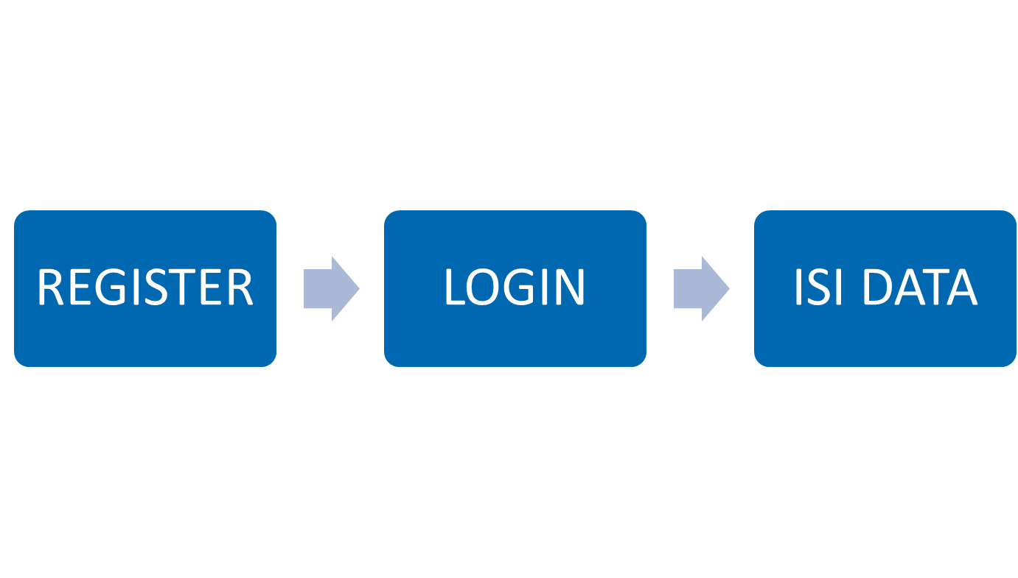
WORK FLOW

Slide 4
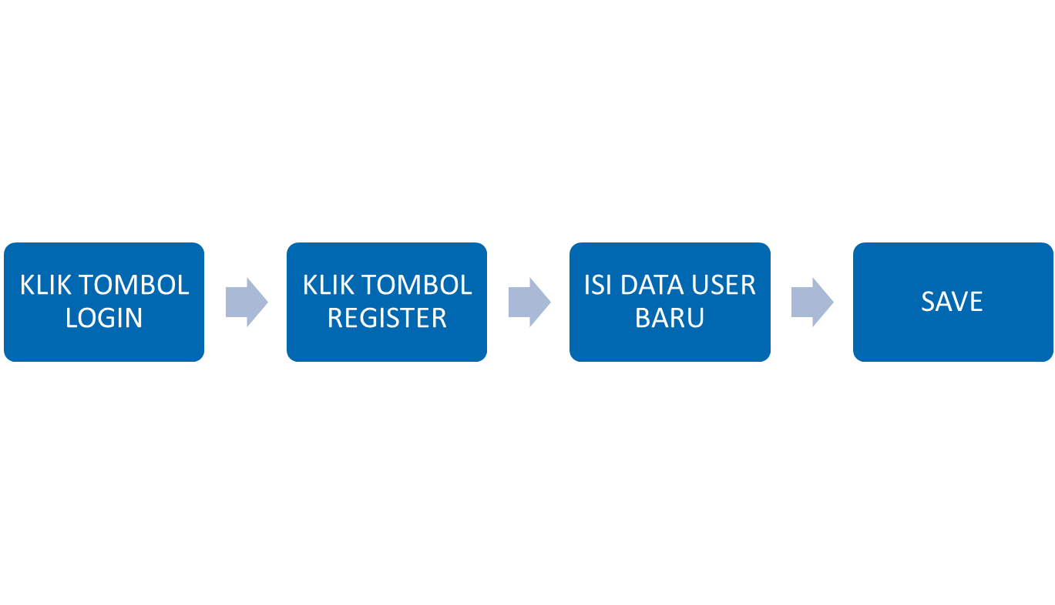
WORK FLOW REGISTER

Slide 5
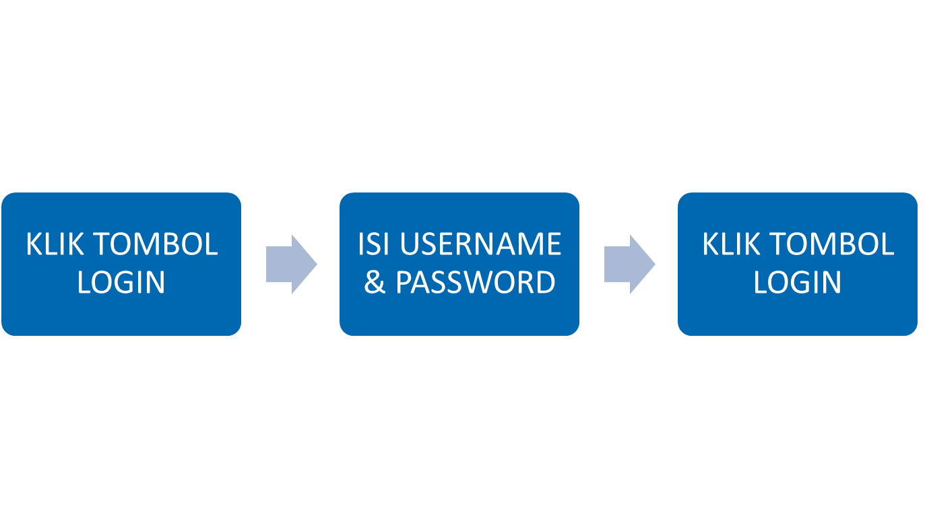
WORK FLOW REGISTER

Slide 6
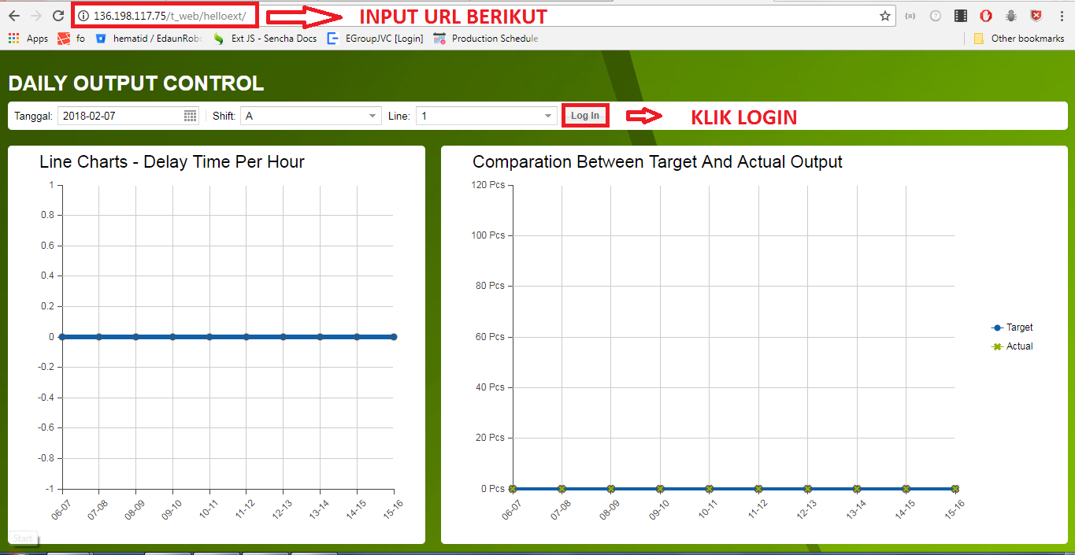
WORK FLOW LOGIN

Slide 7
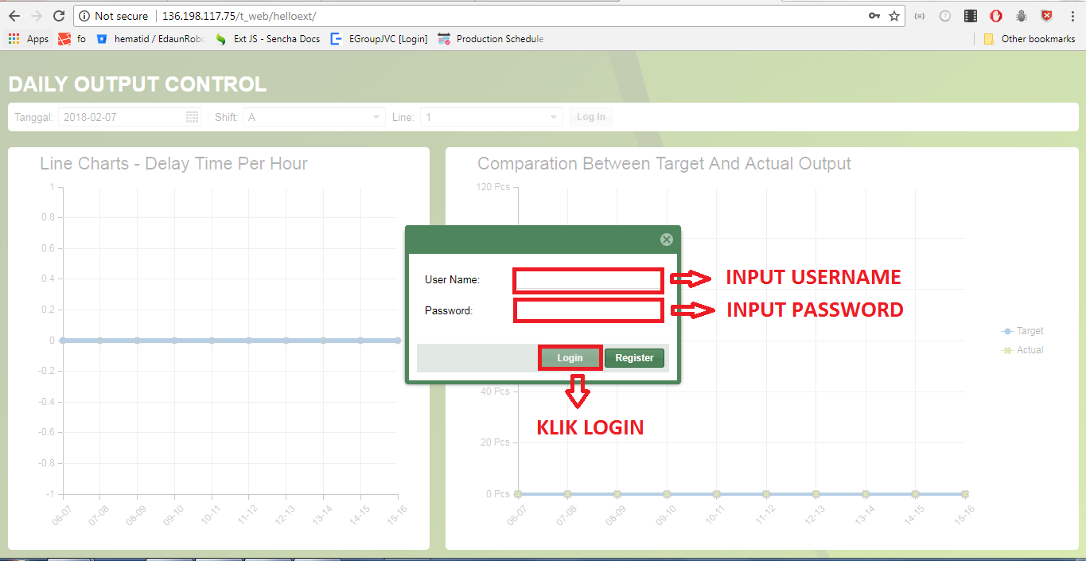
WORK FLOW LOGIN

Slide 8
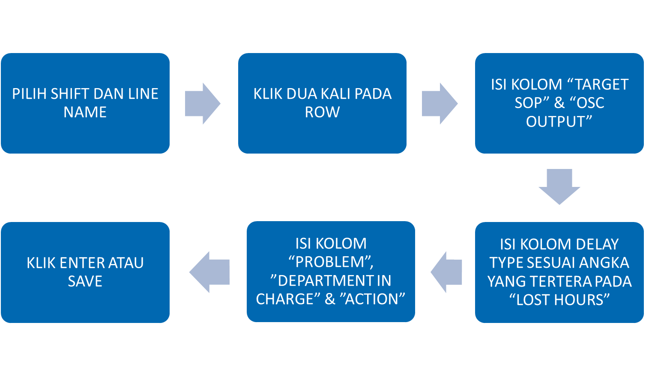
WORK FLOW ISI DATA

Slide 9
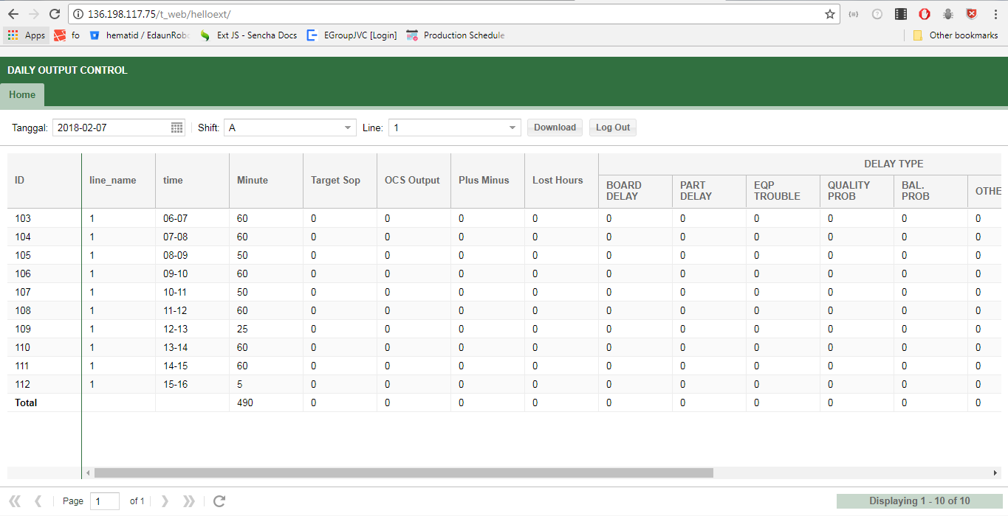
WORK FLOW ISI DATA

Slide 10
WORK FLOW ISI DATA
DOUBLE CLICK DI ROW

Slide 11
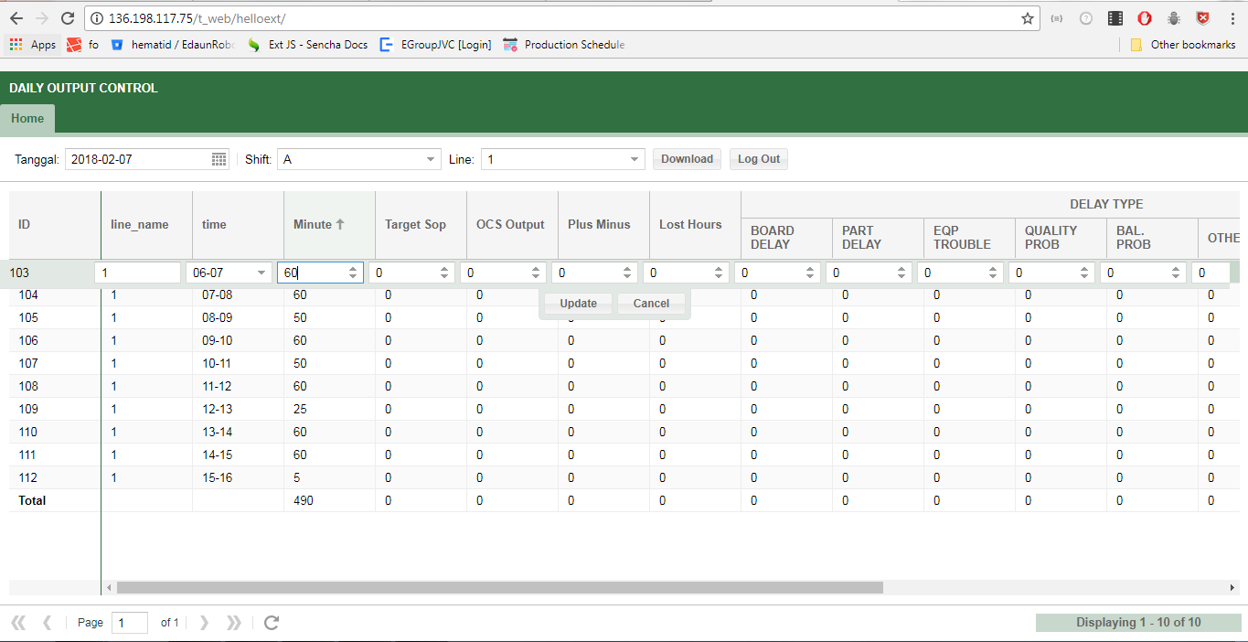
WORK FLOW ISI DATA
KLIK ENTER ATAU UPDATE UNTUK SIMPAN PERUBAHAN
KLIK CANCEL UNTUK MEMBATALKAN PERUBAHAN
KLIK ENTER ATAU UPDATE UNTUK SIMPAN PERUBAHAN

Slide 12

IT Department

